Slide 1
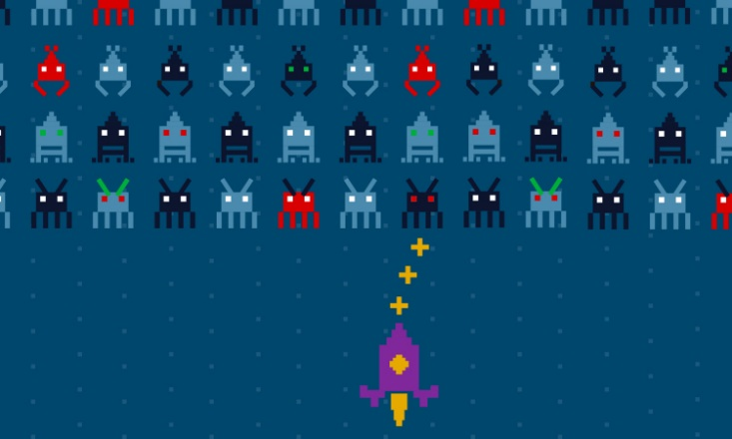
Computing for Social Good CSE 120 Winter 2019
Slide Credits: Michael Ball, Ruth Anderson, and Larry Snyder
Instructor: Teaching Assistants:
Justin Hsia Ann Shan, Eunia Lee, Pei Lee Yap, Sam Wolfson, Travis McGaha
The smart strategy that one LGBTQ forum uses to keep out trolls and bullies
“Turn it into a game, says technologist Esra’a Al Shafei. Thanks to features like a point system and a leaderboard, her small site for LGBTQ people in the Arab world is not only fun to use — it’s free from harassers.
“While many gay people in the Middle East have turned to social media and dating apps to find community and acceptance, those platforms are not always safe. In Egypt, for example, law enforcement regularly pose as LGBTQ users on dating apps like Grindr, Hornet and Growler to entrap and arrest people.”
https://ideas.ted.com/the-smart-strategy-that-one-lgbtq -forum-uses-to-keep-out-trolls-and-bullies/

Slide 2
Administrivia
Assignments:
CS in Your Future in section tomorrow (3/14)
Final Project code, video, and README due Friday (3/15)
Final Review: Sunday, March 17, 4-6 pm, LOW 101
Final Exam: Tuesday, March 19, 3-4 pm, SAV 264
Scheduled exam slot is 2:30-4:20, but exam will be 60 min
10% of your overall course grade
Two sheets of notes are allowed (letter-size paper, double-sided, handwritten)

Slide 3
Why So Negative?
Computing is amazing and has reshaped our society
The positives are usually more readily apparent
New innovations survive based on adoption; inventors and marketers must sell you on the benefits
Today, want to focus on the ways computing can be used for social good
But we hope you’ll still analyze each situation with an eye on the ethics and potential consequences
Change: http://change.washington.edu
“Explore the challenges of developing technology in the context of positive social change.”

Slide 4
Outline
Accessibility
Technology and the Developing World
Crowdsourcing

Slide 5
Accessibility
One definition:
“The ability for someone to use a service or tool.”
This is very broad
Often talked about in the context of disabilities, but access applies to everyone and any situation

Slide 6
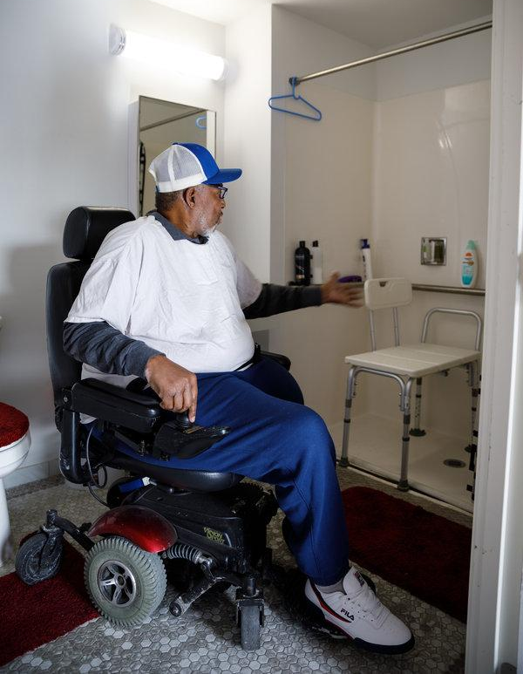
Accessibility Benefits Example
“Where Luxury Meets Accessibility”
https://www.nytimes.com/2019/ 02/08/realestate/where-luxury- meets-accessibility.html
“Even fully mobile residents might enjoy the spaciousness in the bathrooms. ‘It’s like we used one stone to kill two birds,’ he said, as ‘it also adds a sense of luxury.’ ”

Slide 7
1 in 5 Americans Have a Disability
This really depends on how you define disability and ask the question
1 in 5 comes from the US Census Bureau
https://www.census.gov/newsroom/releases/archives/miscellaneous/cb12-134.html
1 in 7, 1 in 8 are other common answers, or 1 in 4 “adults”
1 in 3 above the age of 65
https://disabilitycompendium.org/sites/default/files/user-uploads/2017_AnnualReport_2017_FINAL.pdf
Disability is situational, by time and location
Bottom line: it’s a large number of people

Slide 8
Accessibility Needs are Situational
Breaking a bone → limited mobility for a while
Repetitive Stress Injuries (RSIs) can be intermittent
Getting your pupils dilated
Using GPS/Maps while driving (vs walking)
Not being able to text easily because you’re doing it under a desk/table

Slide 9
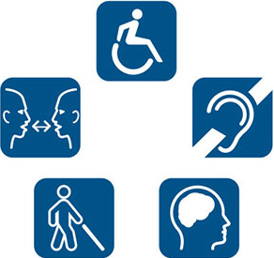
Broad Categories of Disabilities
These do not cover all disabilities, but can help you think about users of your applications:
Auditory
Cognitive and neurological
Physical (motor control)
Speech
Visual (blind and low vision)
More: https://www.w3.org/WAI/people-use-web/abilities-barriers/
Notes:
Sight: blind, low vision, color blind
Hearing: deaf, hard of hearing
Speech: limited ability to speak, stuttering
Mobility: limited ability to walk, use hands, arms
Cognition: dyslexia, short-term memory loss, dementia
Multiple: deaf-blindness

Slide 10
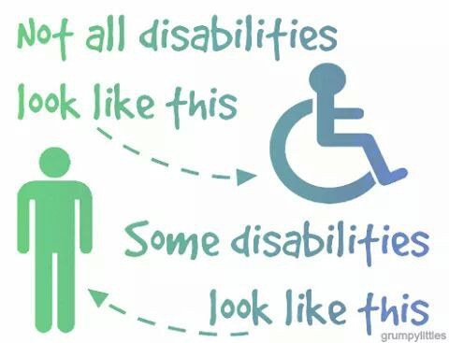
Broad Categories of Disabilities
These do not cover all disabilities, but can help you think about users of your applications:
Auditory
Cognitive and neurological
Physical (motor control)
Speech
Visual (blind and low vision)
More: https://www.w3.org/WAI/people-use-web/abilities-barriers/
Notes:
Sight: blind, low vision, color blind
Hearing: deaf, hard of hearing
Speech: limited ability to speak, stuttering
Mobility: limited ability to walk, use hands, arms
Cognition: dyslexia, short-term memory loss, dementia
Multiple: deaf-blindness

Slide 11
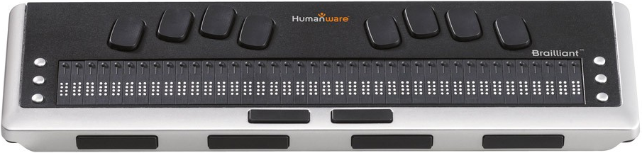
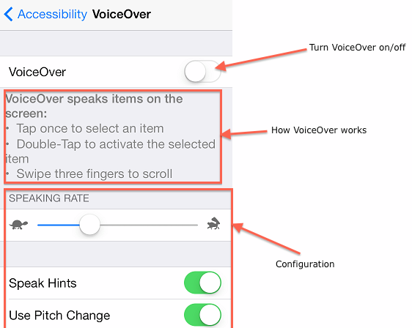
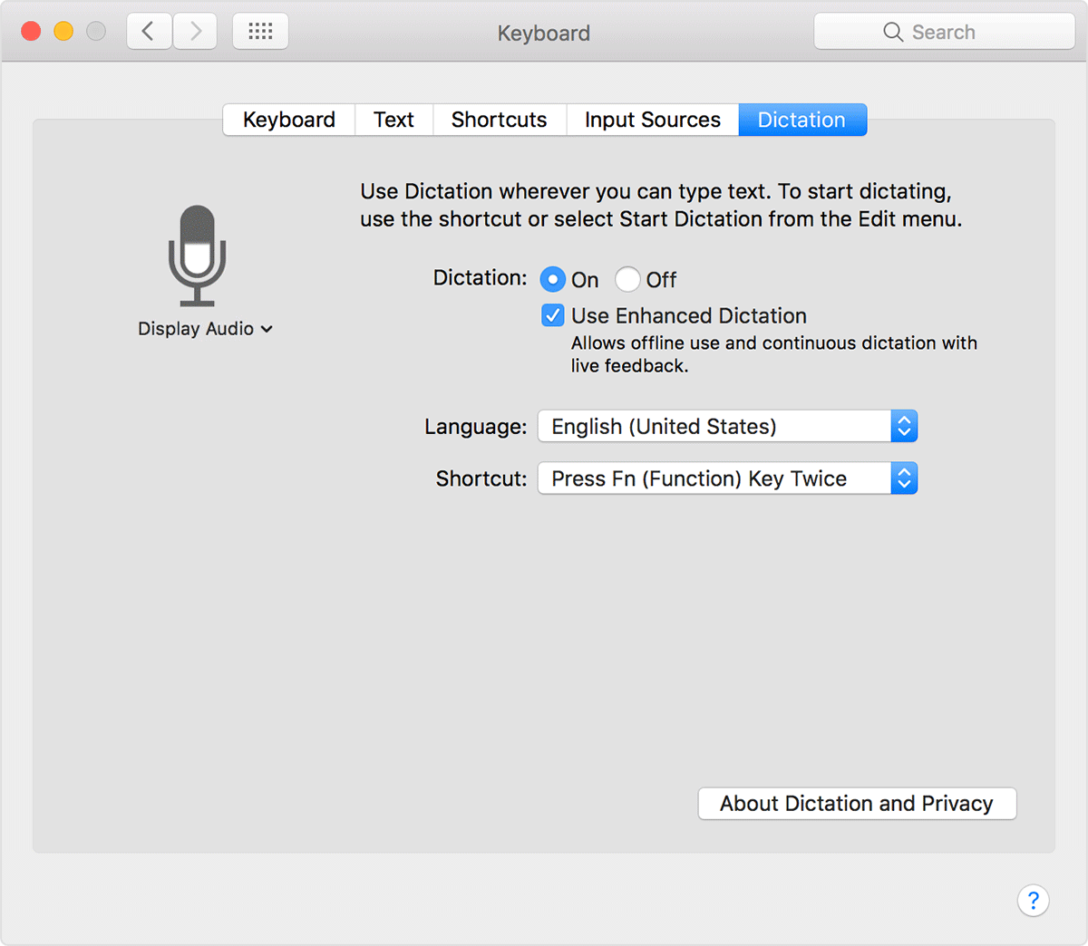
Assistive Technology for Visual Impairment
Screen readers – text-to-speech software
Dictation programs – speech-to-text
Braille displays

Slide 12
Screen Reader Technology
What are the steps necessary to implement text-to-speech?
High resolution scanning/imaging of documents
Character recognition from bits (OCR)
Word identification
Speech synthesis

Slide 13
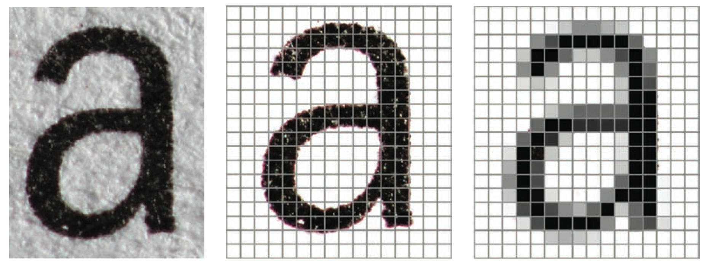
Imaging of text
A scanner produces an array of pixels:
A photo (image) is already an array of pixels!
Print on Paper
Scanner In
Scanner Out

Slide 14
Optical Character Recognition (OCR)
The identification of printed characters using photoelectric devices and computer software
A combination of pattern recognition, artificial intelligence, and computer vision
This is really hard!
Typography is an art form, and font design is a creative field
g g g g g g g g g g g g g g g
A sampling of the character 'g', all of which are 48 point size

Slide 15
Speech Synthesis
Even after figuring out what the text is, saying it correctly is tough!
English is a particularly quirky language – context matters!
Heteronyms: e.g. “read”, “close”, “tear”
Proper nouns: e.g. “Job”
Acronyms: e.g. “eta” vs. “ETA”, “CAUSE”
Made-up words: e.g. “nyan cat”, “ghoti”
Notes:
Ghoti: “gh” as in “tough”, “o” as in “women”, “ti” as in “nation”

Slide 16
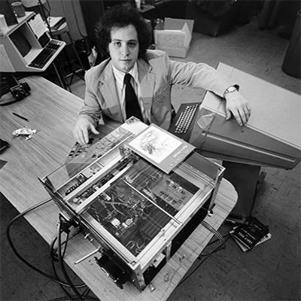
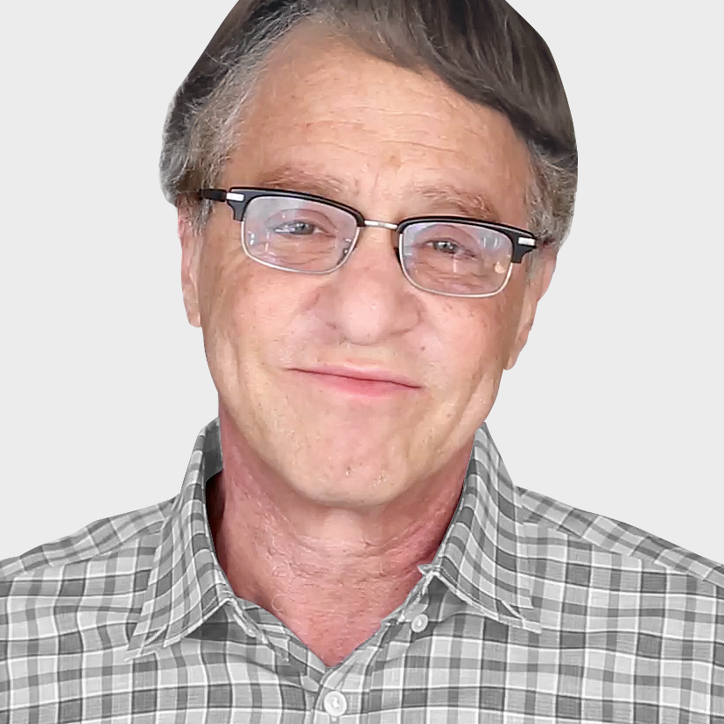
Kurzweil Reading Machine
The first commercial reading machine built by Ray Kurzweil in 1975

Slide 17
Kurzweil Reading Machine
The first commercial reading machine built by Ray Kurzweil in 1975
“The Kurzweil Reading Machine was a breakthrough that changed my life. With the Kurzweil Reading Machine, I could read anything I wanted with complete privacy: music lyrics, letters from my children, the latest best sellers and magazines, memos from my business associates. It gave blind people the one thing that everyone treasures, which is independence.” – Stevie Wonder

Slide 18
Other Applications for Text-to-Speech
Visual disability:
Have books or notes read to them
Speech disability:
Can communicate “verbally” by typing
No disability:
Hands-free text reading
Voice anonymization

Slide 19
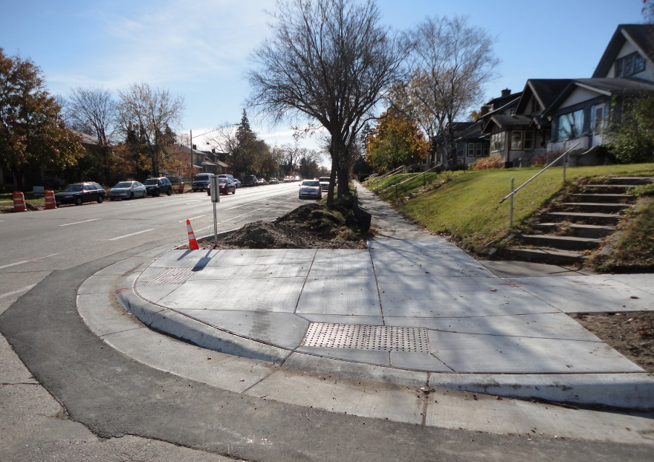
Innovations from Accessible Development
Technologies designed to assist the disabled in society usually turn out to be extremely useful to everyone
It’s the right thing to do AND everyone benefits! ☺
Other Examples:
Captions
Electric toothbrush
Curb cuts
https://99percentinvisible.org/ episode/curb-cuts/

Slide 20
Accessible Technology at UW
Accessibility Technology Research in CSE
http://www.cs.washington.edu/people/faculty/ladner/research
Taskar Center for Accessible Technology (TCAT)
http://tcat.cs.washington.edu/
Mobile + Accessible Design (MAD)
http://depts.washington.edu/madlab/

Slide 21
Outline
Accessibility
Technology and the Developing World
Crowdsourcing

Slide 22
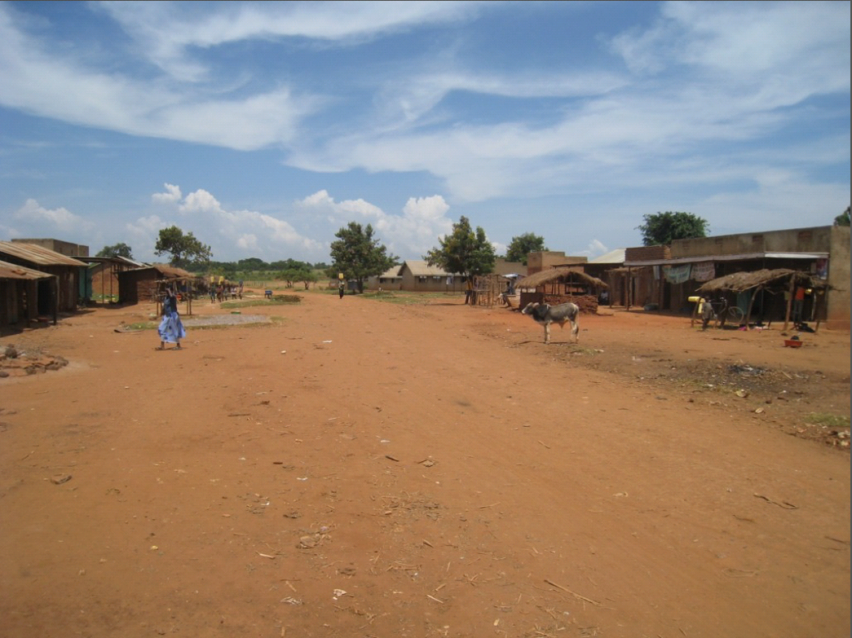

Slide 23
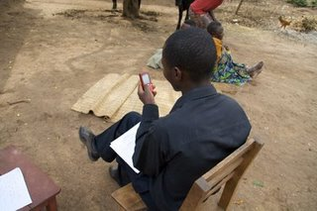
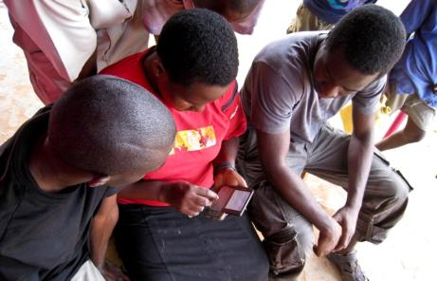

Slide 24
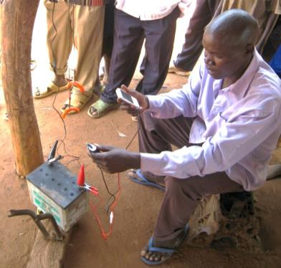
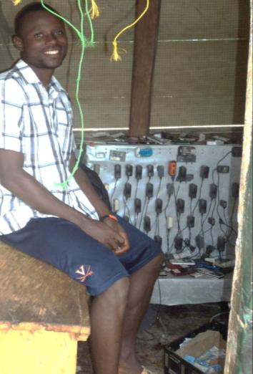
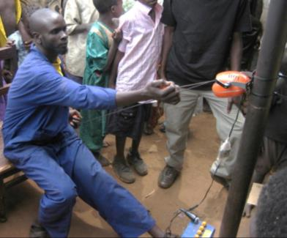

Slide 25
Information & Communication Technology for Development (ICTD)
Goal: Improve the lives of people in developing regions through the use of technology
An interdisciplinary field: public health, education, agriculture, business
An active area of research in computing
UW CSE: http://ictd.cs.washington.edu
Research groups at universities & companies like Microsoft
Many conferences on this topic
e.g. https://acmcompass.org, https://www.ictdx.org/

Slide 26
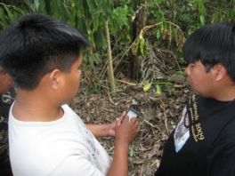
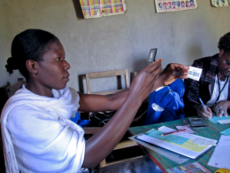
Technology in the Developing World
Health
Monitoring vaccines & vaccinations
Education
Increasing access to high quality teachers in rural areas
Agriculture
Teaching new & effective farming practices
Business
Improving microfinance record keeping with cell phones in India
Photos: Open Data Kit

Slide 27
Designing Technology for Unfamiliar Environments
Physical environment
Low cost
Low power
Low connectivity
Users & cultural context
Illiteracy
Familiarity & trust of technology
Notes:
Beware of savior complex!

Slide 28
Example:
How can the lives of the billions of people who live on a few dollars a day be improved?
Many avenues for improvements: health, governance, education, poverty, food security, environment, infrastructure, civil strife
Strong evidence that improving access to financial services can help people stay out of poverty
Poor pay more for services
Create new livelihood opportunities
Allow more efficient delivery ($ and other services)
Savings provide a buffer against financial shocks

Slide 29
Example: Digital Financial Services (DFS)
DFS can be a pathway out of poverty
Financial Services for the Poor
Remittances
Savings accounts
Government payments
Digital payments
Insurance

Slide 30
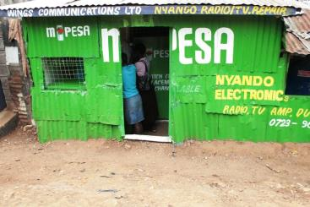
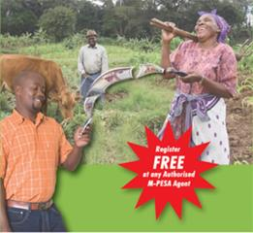
Mobile Money
Send money instantaneously via phone to remote locations
Must rely on basic phones (and SMS) – no Venmo ☹
Users often don’t have bank accounts
https://www.nytimes.com/2017/05/09/opinion/in-kenya-phones-replace-bank-tellers.html
Notes:
She could buy a money transfer at a bank. Her parents would travel to the nearest town to retrieve it. And transfers were not instant.
The other way was to find someone going to Muranga, perhaps a bus driver, and give him an envelope of cash.
M-Pesa is available to any Safaricom customer. But it’s only useful if there’s a nearby agent who can accept or disburse cash.

Slide 31
Digital Financial Services Challenges
Security of mobile money
Android app security
Usability and resilience to poor infrastructure are key
Usability
Simplification of process
Lack of trust is a deterrence to adoption
Fraud detection
Transaction records to detect potentially fraudulent use
Consumer Education
Understanding of basic financial instruments
Integration of mobile money into broader services
Payment for services (e.g. school fees)

Slide 32
Outline
Accessibility
Technology and the Developing World
Crowdsourcing

Slide 33
Crowdsourcing
Distributed problem-solving and production technique
Problems are broadcast to an unknown group of “solvers”
Those solvers (the crowd) submit solutions that become the property of the broadcaster
They are compensated in some form — money, prizes, community accolades, intellectual satisfaction, skill development, etc.
Computers are a perfect agent for this!

Slide 34
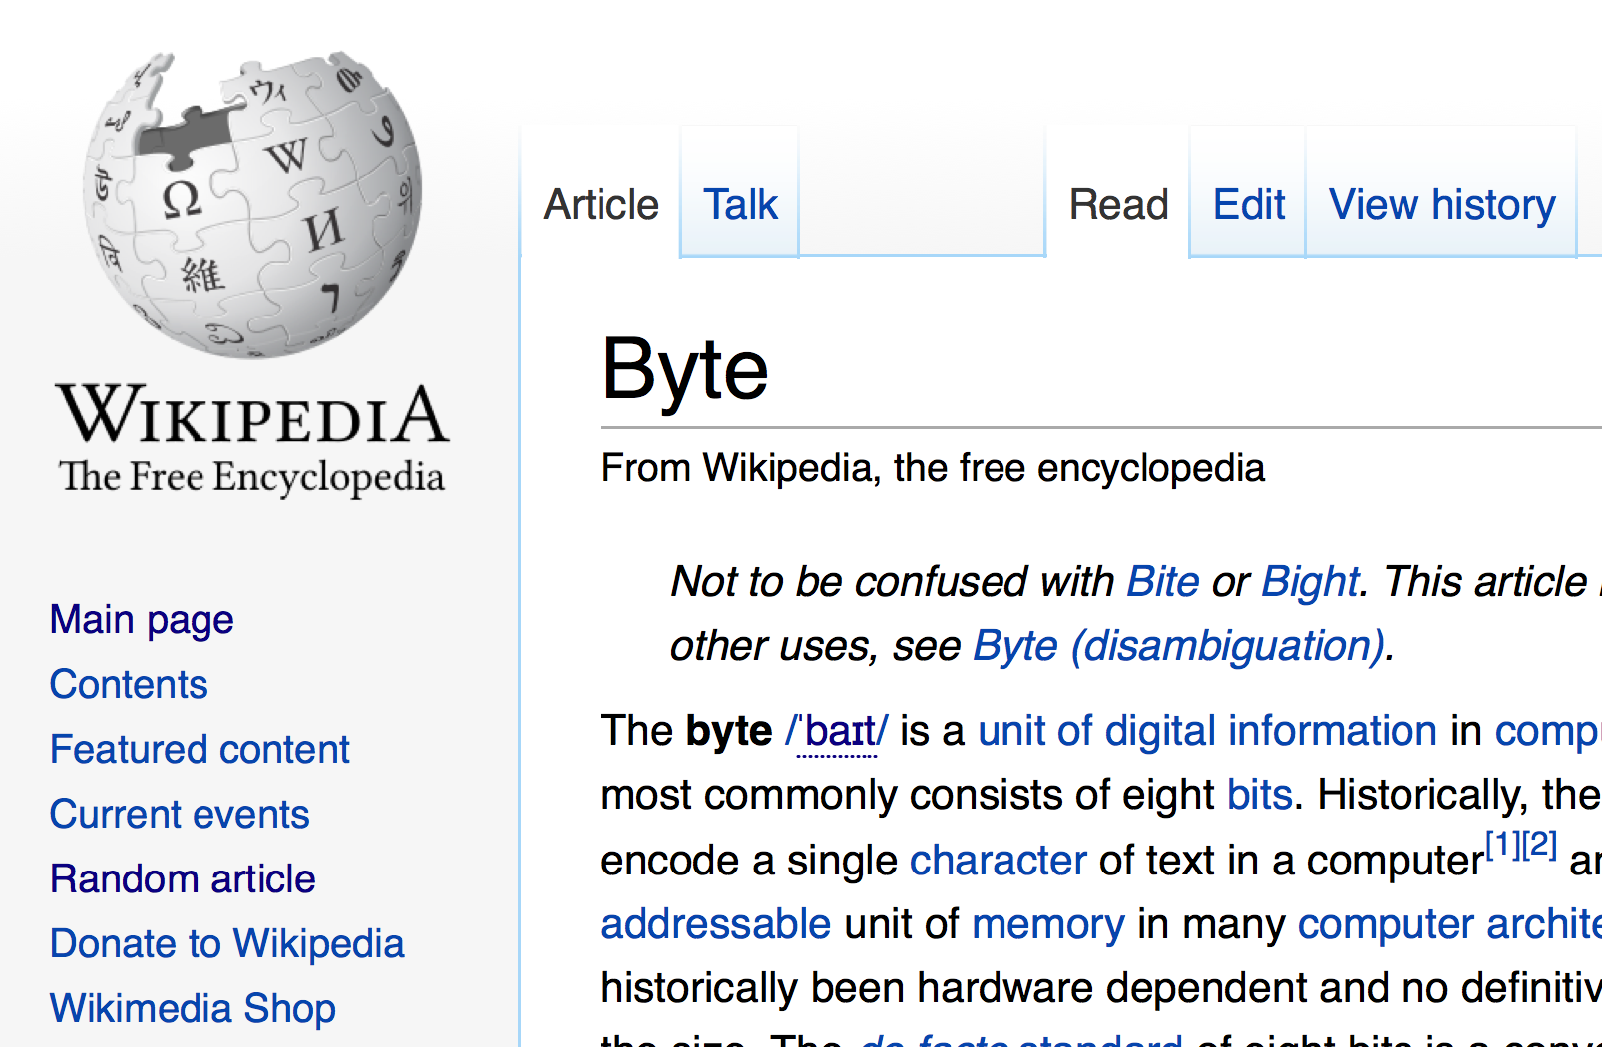
Wikipedia – Crowdsourced Knowledge

Slide 35




Crowdfunding – Crowdsourced Money
The practice of funding a project or venture by raising small amounts of money from a large number of people, typically via the Internet

Slide 36
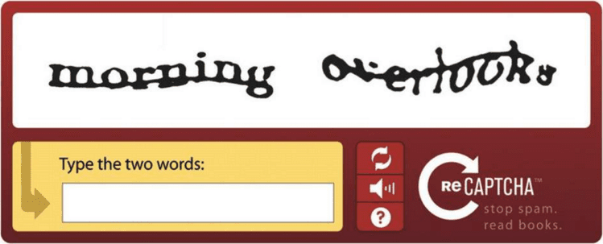
Crowdsourced Digitization
CAPTCHA stands for “completely automated public Turing test to tell computers and humans apart”
User must decipher distorted characters
Criticized, especially by those with disabilities
Prevent spam, protect registration, hide email addresses
reCAPTCHA uses CAPTCHAs to digitize books
Original slogan was “Stop Spam, Read Books.”
Has since introduced different systems
Notes:
http://www.captcha.net/

Slide 37
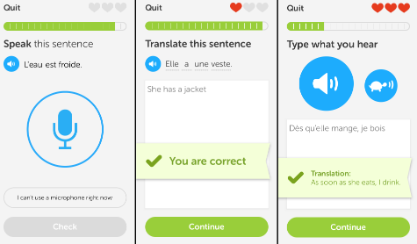
Duolingo – Crowdsourced Translation
https://www.ted.com/talks/luis_von_ahn_massive_scale_online_collaboration?language=en#t-679097

Slide 38
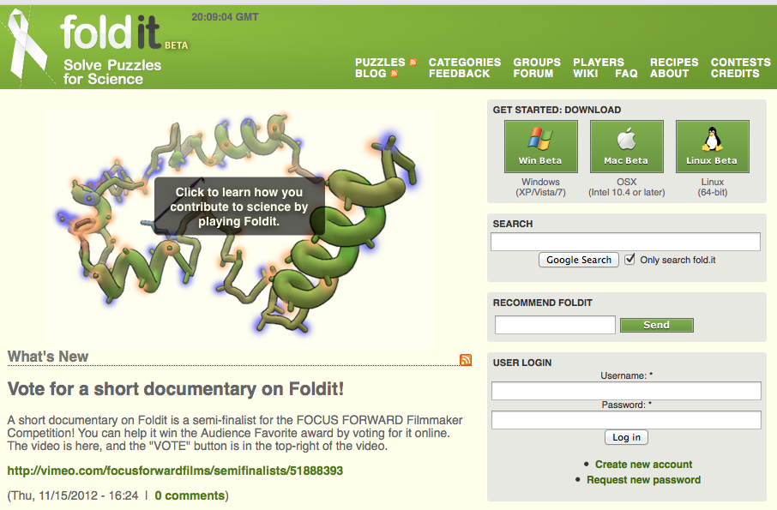
fold.it
Notes:
https://fold.it/portal/

Slide 39

fold.it
https://vimeo.com/51888393

Slide 40
Why Does Crowdsourcing Work?
People bring a variety of skills to the problem
Gamers may be better at 3D visualization than people with medical research knowledge
Collective intelligence can sometimes trump a few smart people
Motivated “solvers”
Large supply of workers with time to spare
Participating in something new is fun

Slide 41
Computing for Social Good
Computing (and the Internet) allow us to affect the lives of a much wider range of people than ever before
We still need to be aware of the needs of our users and take accessibility into account to not exclude subsets of the population
Designing technology for the developing world must take the environment and culture into account
Crowdsourcing can harness some of the power and reach of the Internet towards shared goals
Lots of other ways to promote social good!

